Slide 1
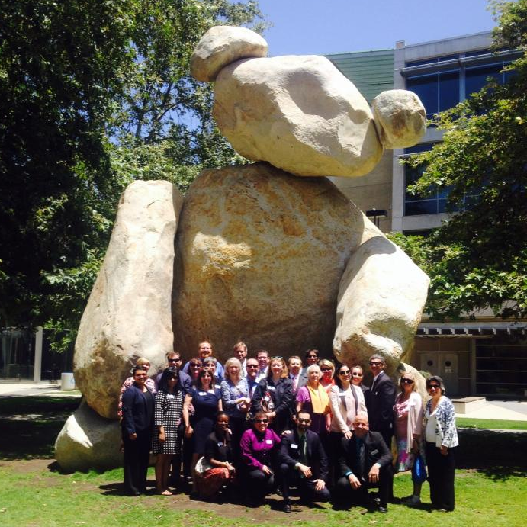
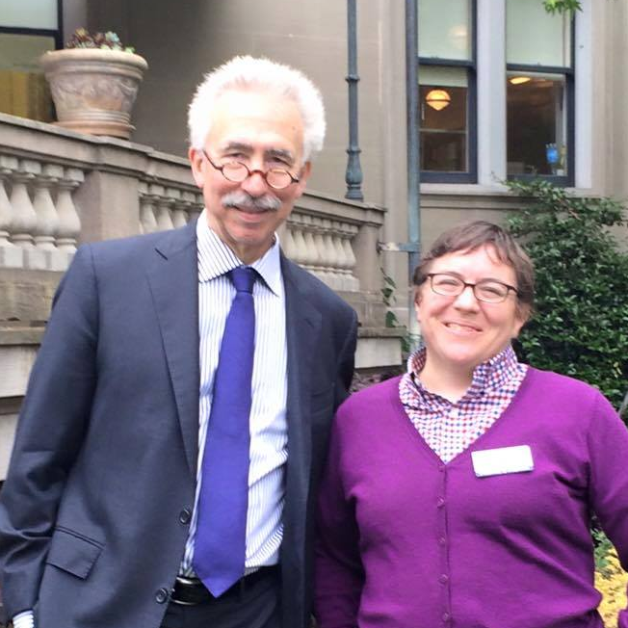
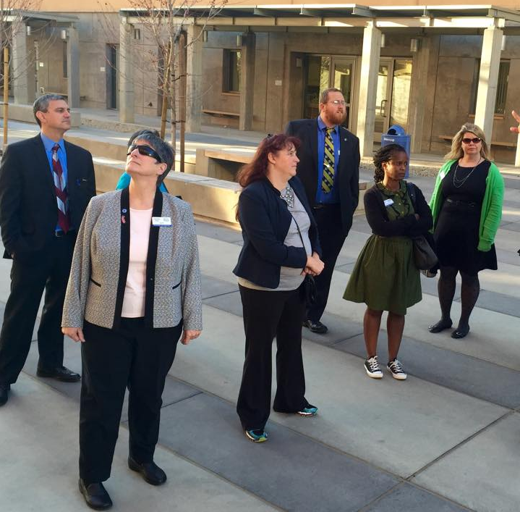
Onboarding Workgroup
ANR | Berkeley | Berkeley Lab | Davis | Irvine | Los Angeles | Merced | Office of the President | Riverside | Santa Barbara | Santa Cruz | San Diego | San Francisco
SAMPLE MARCH WORKGROUP PRESENTATION
Janna LeBlanc, UC Riverside
Michael Luttrell, UC Santa Cruz
Rejeana Mathis (chair), UC Los Angeles
Rochelle Niccolls, UC Berkeley
Notes:
Lina

Slide 2
PROJECT SCOPE
Berkeley | Berkeley Lab | Davis | Irvine | Los Angeles | Merced | Office of the President | Riverside | Santa Barbara | Santa Cruz | San Diego | San Francisco
Research onboarding practices at University of California, study benchmark comparable organizations (public universities and state institutions) and identify best practices.
For purposes of this project, onboarding consists of pre-hire practices, compliance issues, logistics and resources required, and establishing the community connection.
Notes:
Lina

Slide 3
PROJECT MILESTONES
Berkeley | Berkeley Lab | Davis | Irvine | Los Angeles | Merced | Office of the President | Riverside | Santa Barbara | Santa Cruz | San Diego | San Francisco
Research onboarding best practices and procedures | November
Compile and assess current practices at UC | January*
Survey UC staff regarding their onboarding experiences | February
Craft an optimal UC onboarding process | April
Identify ways that Staff Assembly’s potential role | May
*Adjusted timeframe
Notes:
Lina

Slide 4
RECOMMENDATIONS
Berkeley | Berkeley Lab | Davis | Irvine | Los Angeles | Merced | Office of the President | Riverside | Santa Barbara | Santa Cruz | San Diego | San Francisco
Several Recommendations in the report (see handout)
Read through
Ideas, concerns, suggestions by end of meeting?
Each Recommendation is broken down in two sections
Optimal
Minimal
Notes:
Lina

Slide 5
RECOMMENDATIONS: Tracking
Berkeley | Berkeley Lab | Davis | Irvine | Los Angeles | Merced | Office of the President | Riverside | Santa Barbara | Santa Cruz | San Diego | San Francisco
Optimal
OP or campus have system to track process
Minimal
Have checklist available
Follow three crucial aspects outlined in report
Compliance
Logistics
connections
Notes:
Lina

Slide 6
RECOMMENDATIONS: Buy In
Berkeley | Berkeley Lab | Davis | Irvine | Los Angeles | Merced | Office of the President | Riverside | Santa Barbara | Santa Cruz | San Diego | San Francisco
Optimal
Senior Leadership reinforces
Minimal
HR market the process
Notes:
Lina

Slide 7
RECOMMENDATIONS: Implementation
Berkeley | Berkeley Lab | Davis | Irvine | Los Angeles | Merced | Office of the President | Riverside | Santa Barbara | Santa Cruz | San Diego | San Francisco
Optimal
Hiring managers formally trained
Minimal
Hiring Managers and new hires have access to check list
Notes:
Lina

Slide 8
RECOMMENDATIONS: Measuring Metrics
Berkeley | Berkeley Lab | Davis | Irvine | Los Angeles | Merced | Office of the President | Riverside | Santa Barbara | Santa Cruz | San Diego | San Francisco
Optimal
New hires surveyed throughout first year
Minimal
Surveyed at end of first year
Notes:
Lina

Slide 9
RECOMMENDATIONS: Campus Connections through SA
Berkeley | Berkeley Lab | Davis | Irvine | Los Angeles | Merced | Office of the President | Riverside | Santa Barbara | Santa Cruz | San Diego | San Francisco
Optimal
Staff assemblies own campus connection piece
Buddy System
Classes
Part of NEO
New Staff Welcome event
Minimal
Staff assembly is informed of new hires and invite to join listserv
Notes:
Lina

Slide 10
RECOMMENDATIONS: Internal Candidates
Berkeley | Berkeley Lab | Davis | Irvine | Los Angeles | Merced | Office of the President | Riverside | Santa Barbara | Santa Cruz | San Diego | San Francisco
Optimal
Receive full onboarding experience
Minimal
Use checklist to identify where gaps could be and express appreciation for ongoing commitment
Notes:
Lina

Slide 11
RECOMMENDATIONS: Off Boarding
Berkeley | Berkeley Lab | Davis | Irvine | Los Angeles | Merced | Office of the President | Riverside | Santa Barbara | Santa Cruz | San Diego | San Francisco
Optimal
Mandatory off-boarding or exit interviews to find out exactly why people are leaving
Minimal
Exiting employees survey and info periodically reviewed by the campus
Notes:
Lina

Slide 12
CONCLUSIONS
Berkeley | Berkeley Lab | Davis | Irvine | Los Angeles | Merced | Office of the President | Riverside | Santa Barbara | Santa Cruz | San Diego | San Francisco
Effective onboarding requires equal attention to Compliance, Connection and Logistics/Resources. In general, UC campus are most attentive to compliance, followed by logistics/resources, with connection receiving the least attention.
In light of its ability to positively impact recruitment costs, turnover and productivity, leadership at UC campuses need to identify Onboarding as a strategic priority, planning and providing resources and support, accordingly.
Notes:
Lina

Slide 13
QUESTIONS
Berkeley | Berkeley Lab | Davis | Irvine | Los Angeles | Merced | Office of the President | Riverside | Santa Barbara | Santa Cruz | San Diego | San Francisco
Are there any specific items you want us to address that we have not touched on?
Notes:
Lina

